Slide 1
Nutrition Assistant Application

Slide 2
OUTLINE
Introduction
Objectivities
Literature review
Hardware & software Requirements
Flow Chart
Empathy diagram
References

Slide 3
Introduction
My Software Group project is a web App Named as Nutrition Assistant
It estimates food attributes such as ingredients and nutritional values by classifying the input image of food.

Slide 4
Objective
Identify food based on image
Estimate food attribute such as ingredients and nutritional value by using image
Provide nutritional value of the identified food

Slide 5


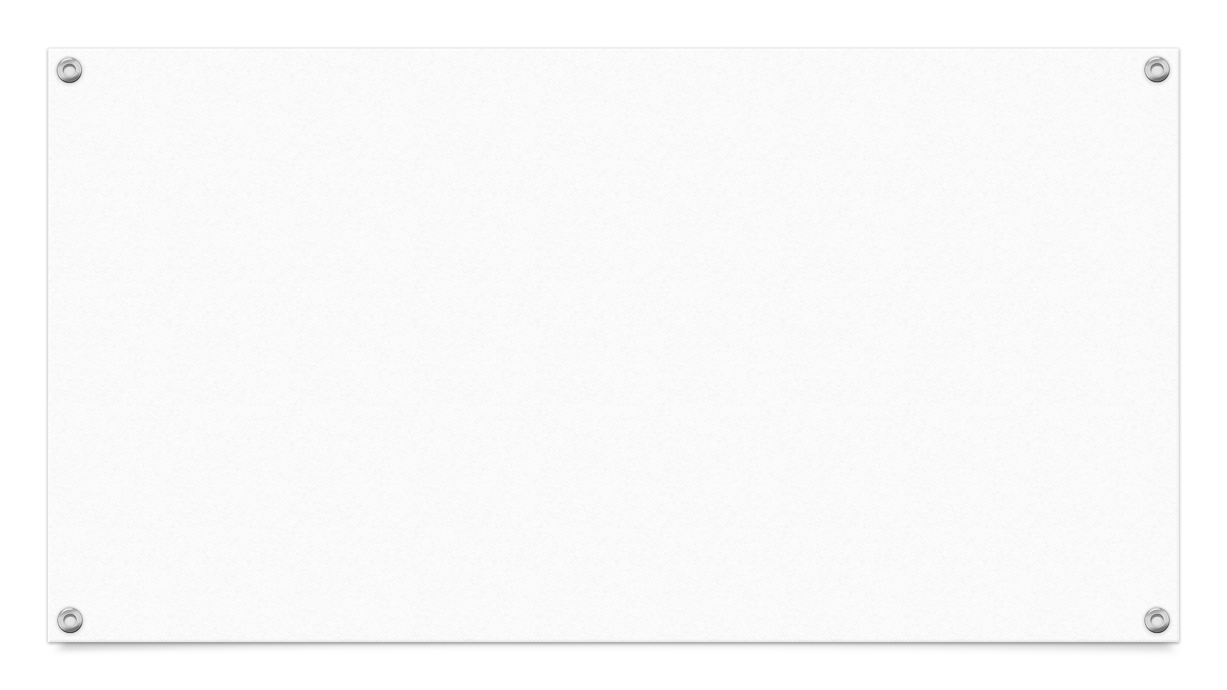
Literature review
TITLE: Smartphone Applications for Promoting Healthy Diet and Nutrition by Steven S, Mary Whitehead
DESCRIPTION: In this article, we review published studies on the acceptability and effectiveness of smartphone apps designed to promote proper diet and nutrition or to lose weight. Of particular interest were randomized control trials of the effectiveness of smartphone apps to promote healthy eating
TITLE : Effects and challenges of using a nutrition assistance system: results of a long-term mixed-method study by Hanna Hauptmann, Nadja Leipold, Mira Madenach, Monika Wintergerst
DESCRIPTION : The research in recommender systems has been recently interested in food recommender systems addressing, among others, nutritional health with different approaches (Trattner and Elsweiler 2018). These systems have the potential to help users navigate the growing amount of multimedia food content (Min et al. 2019a) while fostering healthy eating patterns.

Slide 6
Hardware & software Requirements
Software
Python
Flask
Docker
Windows/linux/Mac
Hardware
8gb ram
Intel core i3
Laptop or Desktop

Slide 7

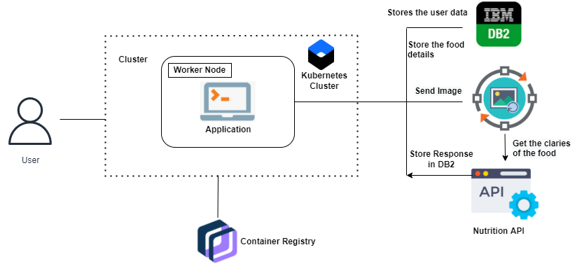
Flow Chart

Slide 8
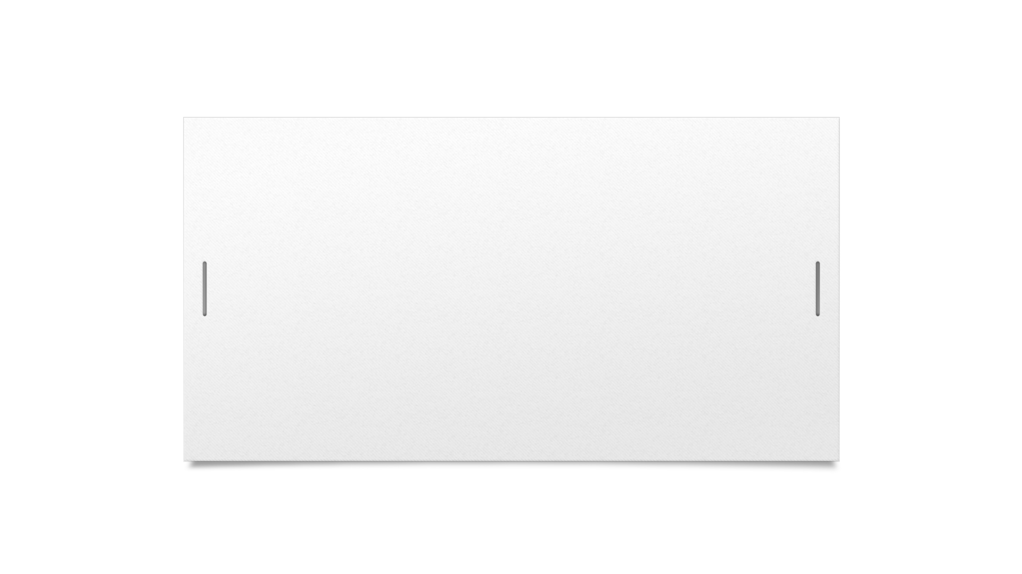
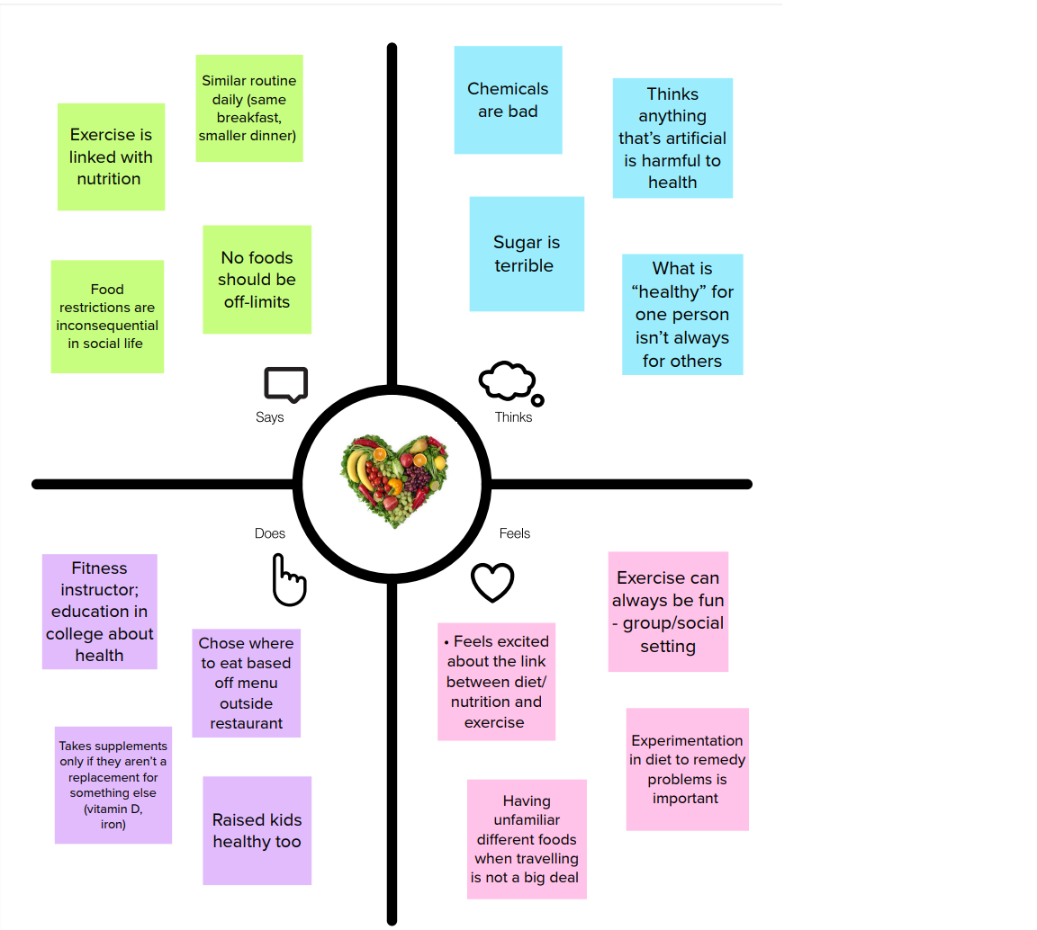

Empathy diagram

Slide 9
References
https://youtu.be/uxZuFm5tmhM
https://flask.palletsprojects.com/en/2.1.x/quickstart/
https://cloud.ibm.com/docs/cli/reference/ibmcloud_cli/get_started.html#getting-started
https://www.youtube.com/watch?v=xVVEZB4sQqo
https://www.geeksforgeeks.org/dockerize-your-flask-app/

Slide 10
THANK YOU

